Slide 1
Retirement Planning

Slide 2
Two Types of Retirement Plans
Defined Benefit Plans
Employer-sponsored plan
Benefits are typically determined according to a formula
Years worked for the company
Average of highest salary over 5-7 years
Age
Often indexed to inflation
Usually guaranteed for life
Pension Benefit Guarantee Corp
“Traditional” Pension
Can be overfunded or underfunded
Not portable

Slide 3
Two Types of Retirement Plans
Defined Contribution Plans
No guarantees on the payout
Employee can often select how much to contribute
Employer frequently matches contributions to a limit
If you leave the company, you can take it with you
Rollover IRA
Employee selects the investments
No obligations by employer other than matching contributions
Cannot be overfunded or underfunded

Slide 4
Social Security
A Defined Benefit Plan
Payout is based on
Quarters worked
Amount contributed
Age you begin receiving benefits
Benefits are for
Life
Last to die (worker and spouse)
Reduced to 50% after worker dies

Slide 5
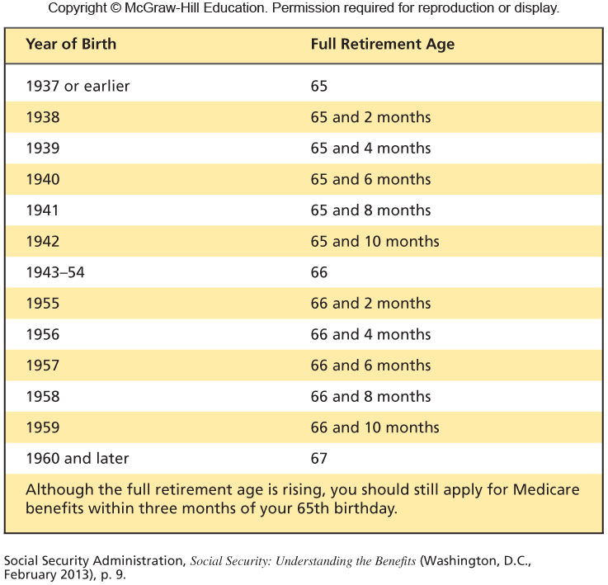
Social Security Retirement Age

Slide 6
When to Start Receiving Benefits

Slide 7
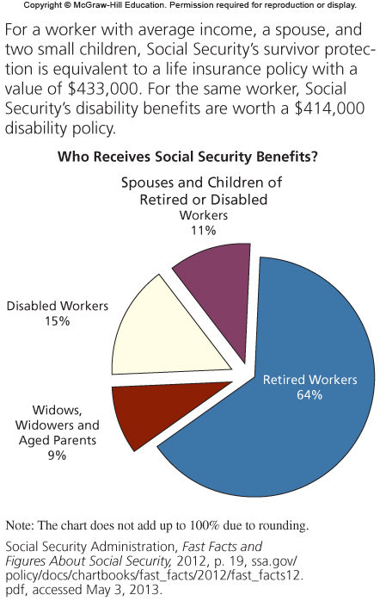
Who Receives Social Security?

Slide 8
Defined Contribution Plans
Traditional IRA
Roth IRA
401(k)
403(b)
Rollover IRA

Slide 9
How much can you Contribute?
IRA - $6,500 per year
$7,500 if you are over 50
401(k) - $23,000 per year
$30,500 if you are over 50

Slide 10
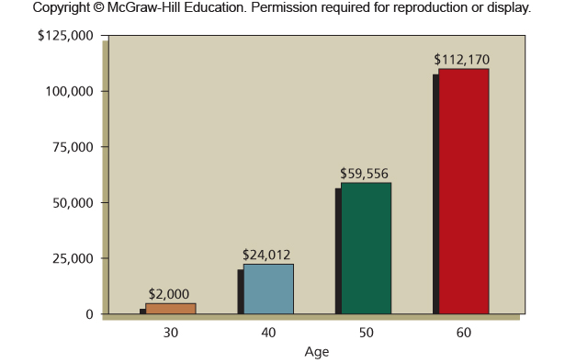
How much does the average person have saved?

Slide 11
How much should you be Saving?
If you start saving at age 25 and you…
Retire at age 62: Save 15 percent of your pay
Retire at age 65: Save 10 percent of your pay
Retire at age 67: Save 7 percent of your pay
Retire at age 70: Save 4 percent of your pay
If you start saving at age 35 and you…
Retire at age 62: Save 24 percent of your pay
Retire at age 65: Save 15 percent of your pay
Retire at age 67: Save 12 percent of your pay
Retire at age 70: Save 6 percent of your pay
If you start saving at age 45 and you…
Retire at age 62: Save 44 percent of your pay
Retire at age 65: Save 27 percent of your pay
Retire at age 67: Save 20 percent of your pay
Retire at age 70: Save 10 percent of your pay

Slide 12
What is the Average Savings Rate?
Under age 35: -1.8%
35-44: 2.6%
45-54: 5.7%
55+: 13%

Slide 13
How much should you have Saved?
By Age 35 – 1X your annual salary
By Age 45 – 3X your annual salary
By Age 55 – 5X your annual salary
By Retirement – 8X your annual salary
The average retirement lasts 21 years
The average person’s savings will last 14 years

