Slide 1
Basic Investments
Personal Finance

Slide 2
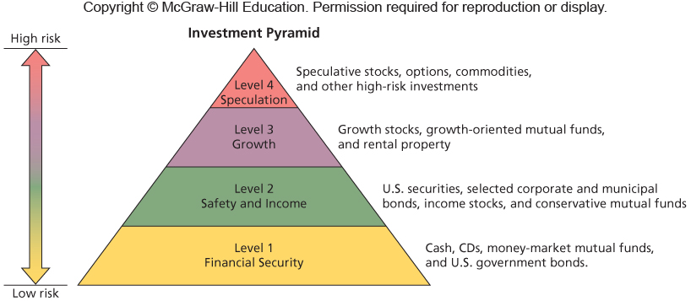
The Investment Pyramid

Slide 3
Certificate of Deposit (Bank CD)
Lending your money to a bank for a specific period of time
Very safe
Insured by Federal Deposit Insurance Corporation (FDIC) – the U.S. government – up to $250,000 per account
Low rate of interest – but better than a checking or savings account

Slide 4
Money Market Account
Very safe, short-term investments
Not always insured by the FDIC
A good place to “park” your money or to have it available at any time
Low rate of return

Slide 5
Bonds
Lending your money to one of the following:
U.S. Government
A municipality (city or state)
A corporation
Can be a long-term or short-term investment
Can be very safe, or quite risky – depending on who you lend to (who issues the bond)
Usually easy to sell if necessary
If interest rates go up, the value of a bond goes down
If interest rates go down, the value of a bond goes up
For more detailed information, see the “Bonds” Word document

Slide 6
Stock
Purchasing a piece of a company – ownership interest
Very important to diversify
Any company can lose a lot of value very quickly
Much less likely that many different companies will all lose a lot of value at the same time
Good long-term investment
But the value will fluctuate, so it is a risky short-term investment
For more detailed information, see the “Stock” PowerPoint

Slide 7
Mutual Funds
Combining your money in an investment along with the money of others.
Each mutual fund has its own investment objective – what it invests in
A fund can invest in money market instruments and be very safe, or small overseas stocks and be very risky – or anything in between
All the above also applies to ETFs (Exchange Traded Funds)
For more detailed information, see the “Professional Asset Management” PowerPoint

Slide 8
Long-Run Returns

