Slide 1
Basic Banking Services
Personal Finance

Slide 2
Checking Account
Usually free if you maintain a minimum balance
Necessary if you receive direct deposit
Pays very little or no interest
You don’t want to keep large amounts of money there for a long time
Usually, you can write as many checks as you want
You may be charged for the cost of printing a new box of checks
If you write a check for more money than you have in your account, it will “bounce”, and you will be charged a fee by the bank and probably whoever you wrote the check to.
Intentionally writing bad checks is a crime

Slide 3
Key Points when Writing Checks
Do not leave room for others to add numbers in the amount
If the “Payable to” section is left blank or payable to “Cash”, it is as good as cash – anyone can use it
Write what the check is for in the memo section
Never write a check for more money than is in your checking account at that moment
Only write today’s date on the check
Do not allow anyone else to access your checking account unless you are willing to give him/her all the money in it
Sign your name the same way every time you write out a check

Slide 4
Debit Card
Tied to your checking account
Anytime you use the card, it automatically and instantly takes the money out of your checking account
It is CRITICAL that you subtract the amount of the purchase in your checkbook each time you use it
Be sure to know how your bank handles it if you try to use your debit card for more than you have in your account
They might decline it
They might “loan” it to you while charging you a fee for this service

Slide 5
Credit Card
Not tied to your checking account
You should plan to pay off the ENTIRE amount each and every month when the bill comes.
If you do, you will not owe any interest
Do not confuse the total balance with your minimum payment due
Some cards will build up frequent flier miles with major airlines
If you do not pay off the entire amount, or are late with a payment, the fees and interest expenses can be significant
There is a maximum you can charge based on your credit history
You can often get this increased if you ask

Slide 6
Credit Card
You often need one to rent a car
It is excellent for emergencies
If you cannot control your spending when you have one, it is best to cut it up.

Slide 7
Other Banking Services
Savings Accounts
Certificates of Deposit (CDs)
Money Market Accounts
Safe Deposit Boxes
Investments

Slide 8
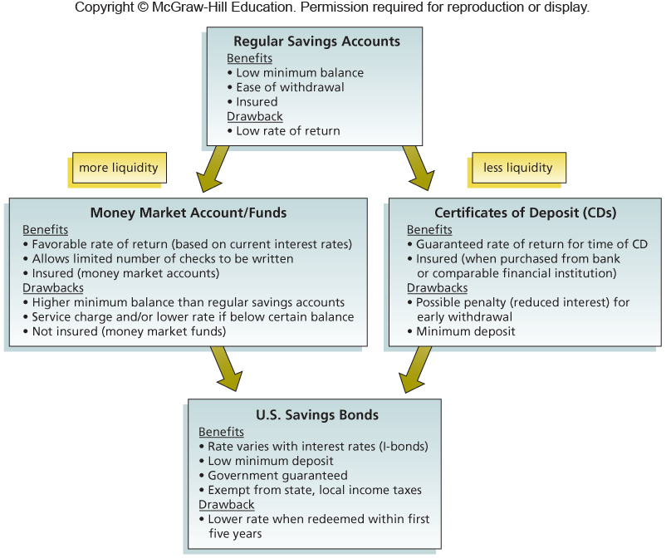
Basic Savings Vehicles

Slide 9
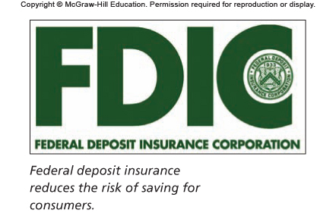
The FDIC
$250,000 per depositor per insured bank

Slide 10
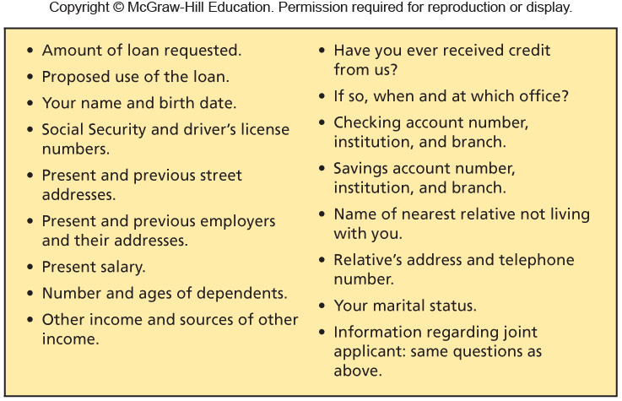
Credit Application Questions

Slide 11
FICO Credit Score
A number generally between 300 and 850
Higher numbers are better
You need about 760 to get the best mortgage rates
You need about 720 to get the best auto loan rates
Your credit reports do not contain your FICO credit score
You can purchase your credit score for $7.95 as shown in your credit/debit assignment

Slide 12
What Impacts Your Credit Score?

